Slide 1


The Job Search

Slide 2




Portfolios
Resumes tell; portfolios show.
Portfolios prove your resume’s assertions by showing examples of your skills, providing evidence of your accomplishments, and documenting your achievements.
Avoid sending an unsolicited portfolio to prospective employers.

Slide 3

Portfolios
You can create a portfolio in at least four ways:
Hardcopy
PDF format
PowerPoint format
Web-based, online format (webfolios)-An online portfolio proves to an employer that you have valuable technology skills.

Slide 4

Methods of Delivery
Mail Version
E-mail Resume
Scannable Resume
Video Resume

Slide 5

Techniques for Interviewing Effectively
Dress professionally.
Be on time.
Watch your body language.
Don’t chew gum, smoke, or drink beverages during the interview.
Turn off your smartphone.
Watch what you say and how you say it.
Bring supporting documents to the interview.
Research the company.
When answering questions, focus on the company’s specific need.
Be familiar with typical interview questions.

Slide 6
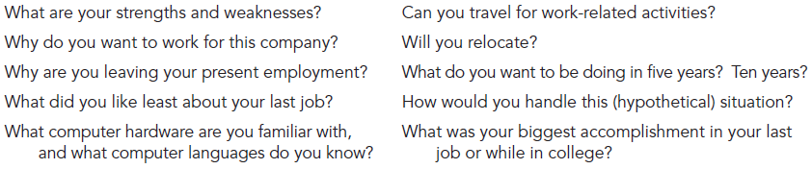
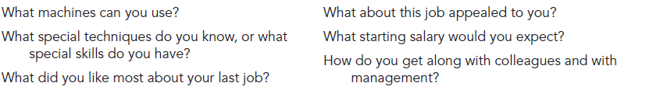
Typical Interview Questions

Slide 7
Criteria for Effective Follow-Up Correspondence
Follow-up accomplishes three primary goals:
Thanks your interviewers for their time
Keeps your name fresh in their memories
Gives you an opportunity to introduce new reasons for hiring you
A follow-up letter or e-mail message contains an introduction, discussion, and conclusion.

Slide 8
Criteria for Effective Follow-Up Correspondence
Introduction. Tell the readers how much you appreciated meeting them. Be sure to state the date on which you met and the job for which you applied.
Discussion. In this paragraph, emphasize or add important information concerning your suitability for the job.
Conclusion. Thank the readers for their consideration or remind them how they can get in touch with you for further information. Don’t, however, give them any deadlines for making a decision.

Slide 9
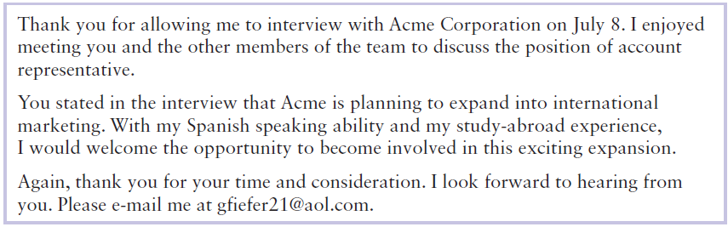

Slide 10
Job Acceptance Letter or E-mail Message
you will want to accomplish the following goals:
Thank the company for the job opportunity
Officially accept the job offer
Restate the terms of employment (salary, benefits, location, position, job responsibilities, and/or start date)

Slide 11
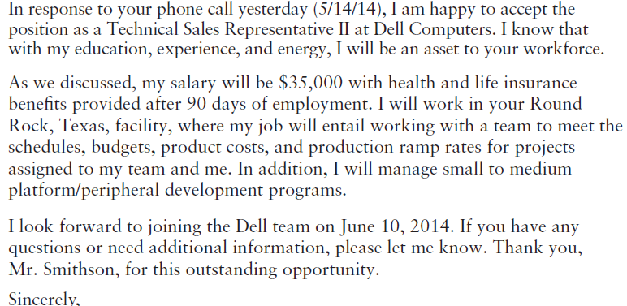

Slide 12
Any Questions?

